Slide 1


Slide 2
Observations: 1.According to the dataset most crimes and arrest have happened in Manhattan and The Bronx. 2.In the dataset it represents an arrest and information on the type of crime, the location and time of enforcement. 3.It shows the demographics of the suspect in detail. 4. Some columns have null values, such as 'PD_CD', 'KY_CD', and 'LAW_CAT_CD', the dataset serves as a robust foundation for in-depth analysis and modeling. 5. Based upon the statistics in the dataset we can see that the index keeps increasing as the years are being recorded and show which boroughs have higher rates of criminal activities in NYC.

Slide 3
path = kagglehub.dataset_download("aishwaryatechie/nypd-arrest-data-2024")
print("Path to dataset files:", path)
# to count the number of unique values in a column,

Slide 4
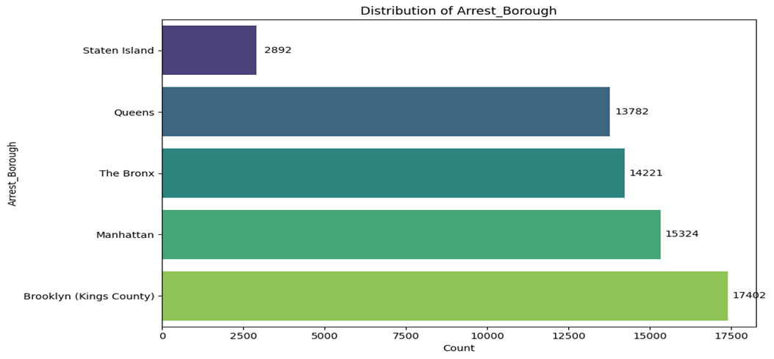

Slide 5
The previous Bar graph
This bar graph shows the distribution of Arrest made throughout the boroughs and is increasing throughout the time.

Slide 9
Conclusion –
New York city crimes and arrests have been outgrown after the pandemic and law enforcement is working on to stop all these criminal issues and concerns.
New York has been marked one of the places that is unsafe for all New Yorkers.
Law enforcements are bringing in new techniques to help prevent any criminal cases and drop the rate of arrest throughout time.
The NYPD Arrest data 2024 gave us a clear idea on how to analyze the data and see how many criminal cases there are throughout the time and are seen at this time.

Slide 10
Sources:
https://www.kaggle.com/datasets/aishwaryatechie/nypd-arrest-data-2024/data

